Slide 1

“Dennis Trumpet bros”
(Provisional Name)

Slide 2
disclaimer
This is a satirical game with the purpose of entertaining, not to promote any political ideology or stance. The content of the game is inspired by fictional and exaggerated situations and should not be taken as a reflection of personal beliefs. Everything in the game is intended to be humorous and is not meant to offend any individual or political group.

Slide 3
Concept
A platformer video game inspired by Donald Trump's exaggerated declarations. The objective is to defeat protesters, avoid obstacles, and collect power-ups in order to annex "MapleLand" as the 51st state.

Slide 4
Mechanics
Collision Detection:
• If the player collides head-on with the enemies, they lose a life.
• The player must jump on the enemies to kill them.
Power-ups:
Red Cap: Makes the player invincible.
Tweet Bird: Gives the player the ability to throw “Tweets” to kill enemies.

Slide 5

Mechanics
Movement:
• Players use the Arrow keys or WASD keys to move the character.

Slide 6
story
“Dennis Trumpet” decides to expand his legacy by annexing “MapleLand” as the 51st state of his kingdom. To succeed, he must navigate obstacles, defeat enemies, and collect power-ups. The final battle is against “Prime Beavister” the leader of “MapleLand”.

Slide 7

sprites

Slide 8

“Dennis Trumpet”

Slide 9

“red cap” Power-up

Slide 10

“tweet bird” Power-up

Slide 11

protestant

Slide 12
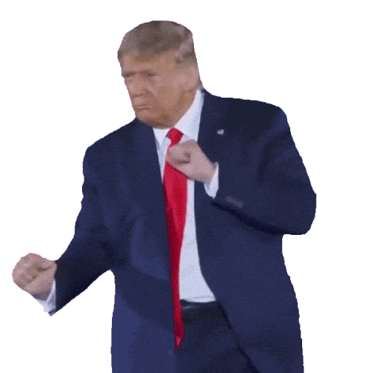
Thank you

